Slide 1

OFFUTURE
Descriptive Data Analysis Report
by Data Craft
Notes:
Greet Audience
Introduce team members - Andre, Katrina, Toby, Ranmi
Today we will present some noteworthy insights as to how offuture performed from 2011 up to 2014
We won’t be making any grand predictions, we would just like to summarise a bit of data for you

Slide 2
Agenda
Offuture did really well! How did it happen?
Profit analysis
Sales analysis
Product analysis
Geographical analysis
Notes:
General trends how we know they did better
We’re gonna take a closer look at some individual products and what we discovered there
Zoom in on specific regions and seen how they’ve contributed to the growth

Slide 3
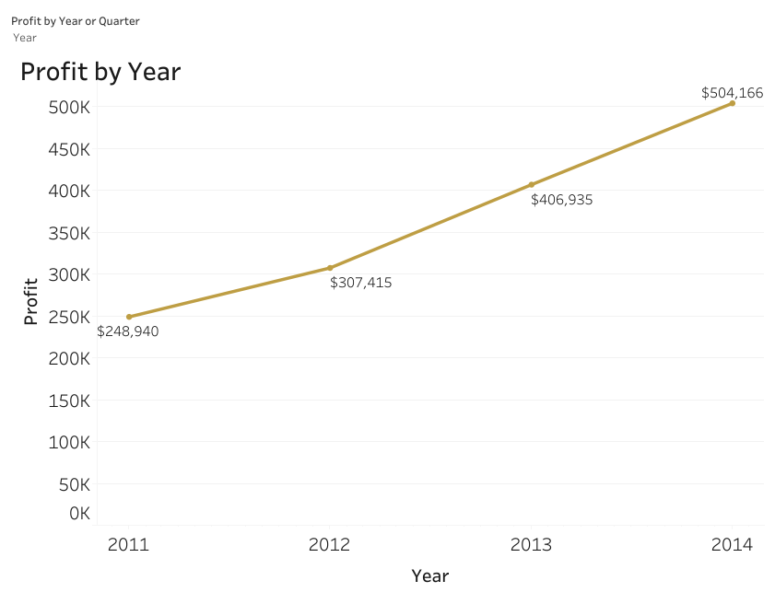
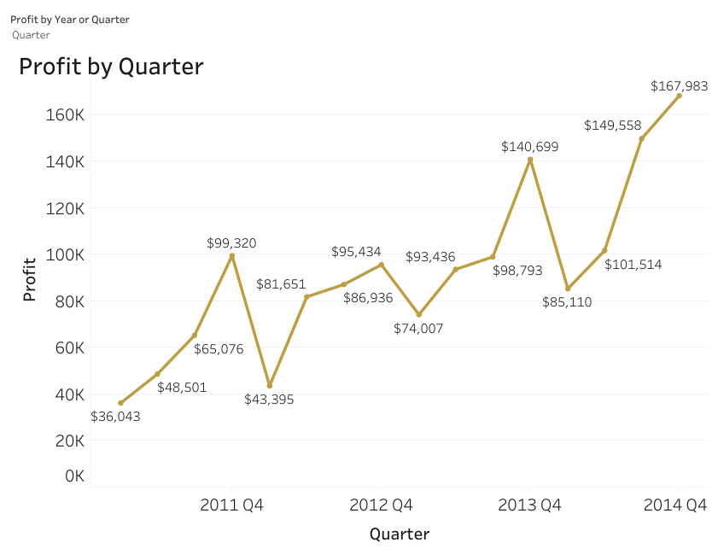
Company Overview
Profit doubled from 2011 to 2014.
Q4 was always the most profitable quarter.
Notes:
During 2011 - 2014 company profits increased
Profits have actually doubled since 2011!
Q4 best performing quarter. Usually slower at the beginning of the year and then gradually increases.

Slide 4
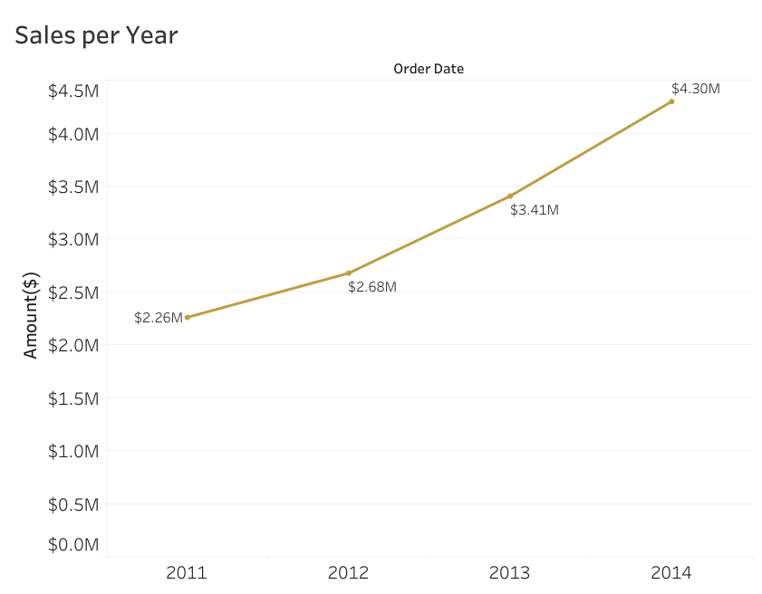
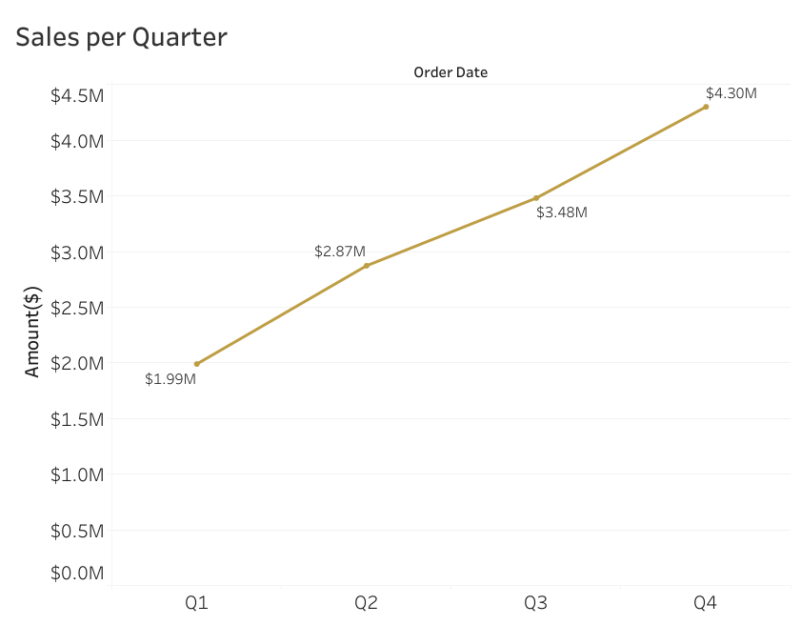
Company Overview
Sales increased from 2011 to 2014.
There was a steady increase in sales from Q1 to Q4 of each year.
Notes:
Similar trend noticed in sales. Over doubled, like profits, over the years. Quarters - increase throughout the year, due to replacing supplies later in the year or opening more budget to allow for luxury purchases

Slide 5
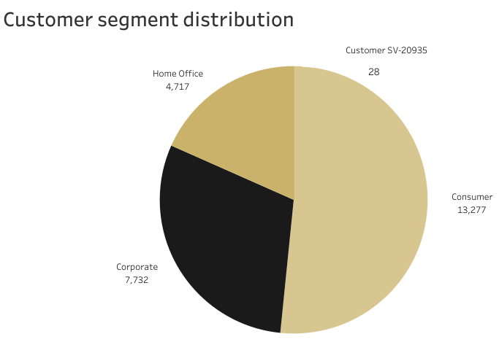
Customer Split
Most customers are consumers.
There is a mystery customer who has made 28 orders.
Notes:
The majority of Offutures customers are individual consumers, with a smaller proportion being corporate clients and home office buyers.
Interestingly, there is an unidentified customer who has placed 28 orders but we have no further information on them and so don’t know which segment they belong to.
To ensure a more comprehensive and accurate understanding of your customer base, we recommend investigating this anomaly further.
Resolving this data gap will enhance the completeness of your database and improve future analysis.
And so what are these customers buying?

Slide 6
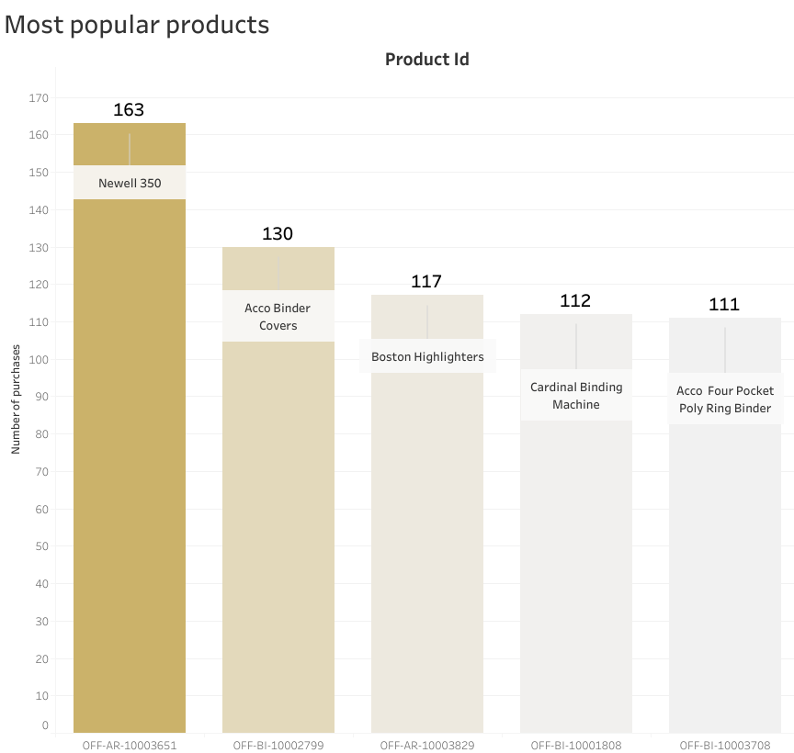
Best Sellers
Smaller, more disposable items are top-sellers.
Notes:
We have found that smaller, more disposable items like binder covers, highlighters, and ring binders are the top-selling items.
This is likely due to their essential role in office organisation and are often bought in bulk or on repeat purchases.

Slide 7
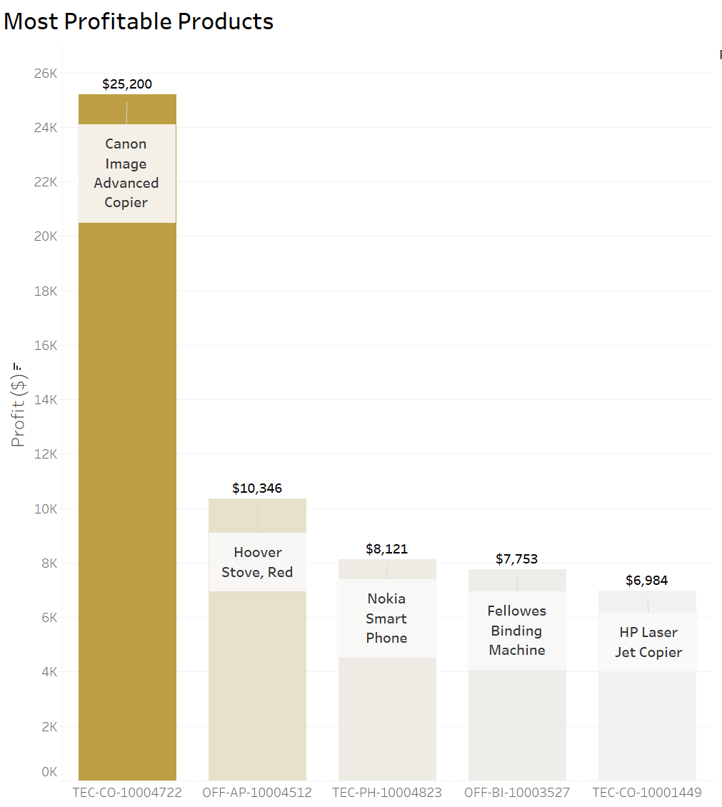
Revenue Generators
Larger, more expensive, and long-lasting items are more profitable.
Notes:
Conversely, the most profitable products are typically larger, more expensive, and long-lasting items, such as copiers, stoves, and phones, which are essential components of most office environments.
While we've seen which products drive the highest profitability, it's equally important to examine the other end of the spectrum.
Let’s now shift our focus to the products that are underperforming or even unprofitable.

Slide 8
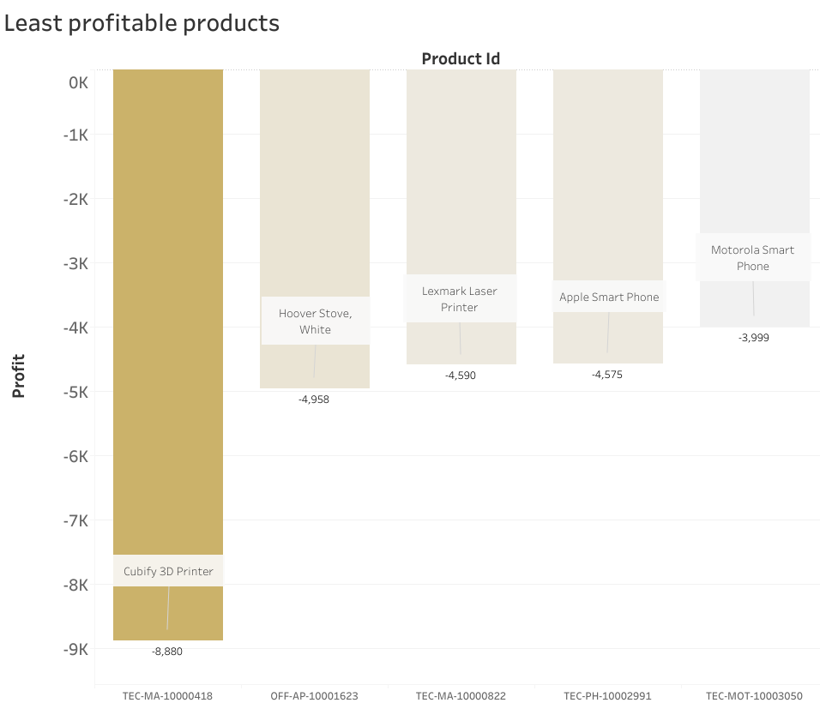
Underperformers
The Cubify 3D Printer is the primary driver of losses, accounting for over $8K in losses.
Overall, selling tables has cost the company $64k.
Some of these products might be older models or discontinued items, leading to lower demand.

Slide 9
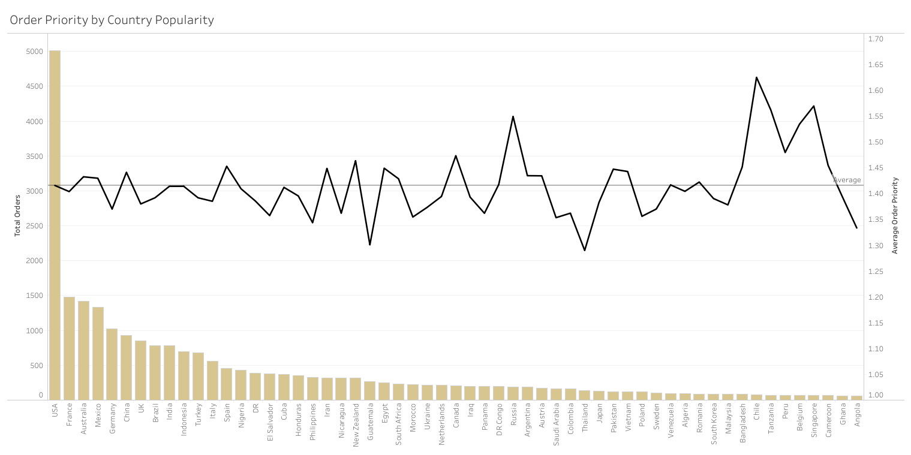
Global Order Priorities
Order priority tracks the mean across all countries.
Global equality - no inherent biases
Notes:
Top countries by order count in order, average order priority shown on the line graph. The higher the order priority, the more urgent the order is. Tends to hover close to the mean - global equality - key advantage. Later deviation due to lower sales data

Slide 10
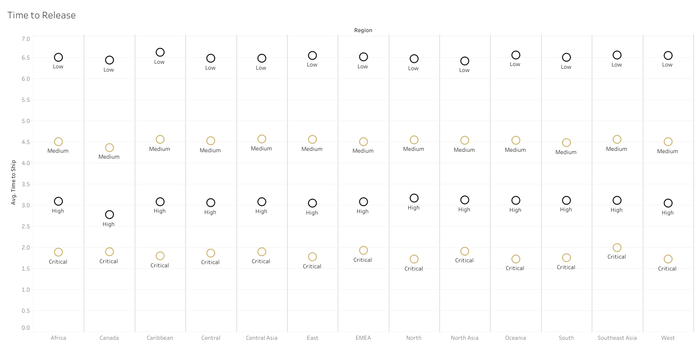
Global Shipping Times
Shipment times remained similar across all countries.
Globalisation - location had minimal impact
Notes:
Shipping speeds follow similarly. Closely packed distribution of shipping speed across all order priorities. True globalisation was achieved as global activity is consistent, global customers expect a standard and they get this anywhere. Likely a big driving force in the overall success and improvement over the years.

Slide 11
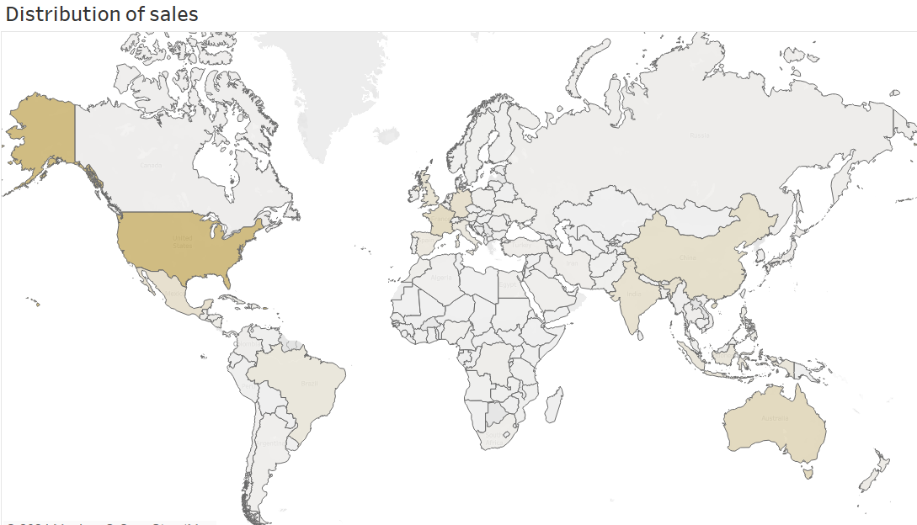
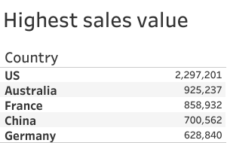
Global Analysis
Most sales came from the US, Australia, France, China and Germany.
Due to large economies and high demand for office supplies.

Slide 12
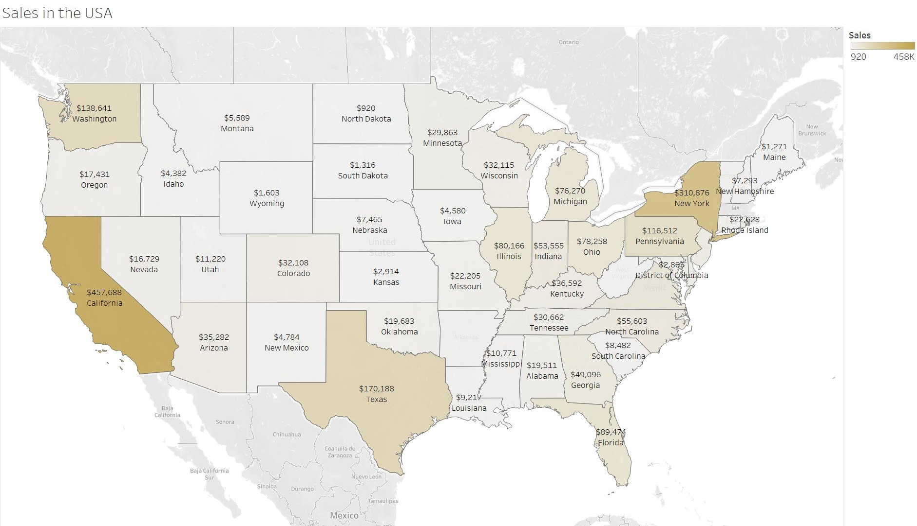
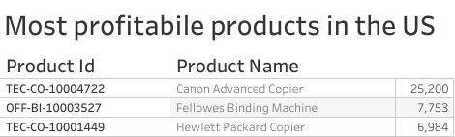
Regional Analysis
California appears to have the most sales
Followed by New York and Texas
Best sellers include the copiers and binding machines, most likely for corporations

Slide 13
Key Takeaways
The business has been very successful in terms of sales and profits.
Smaller, more disposable items are top-sellers.
Larger, more expensive, and long-lasting items are more profitable.
Areas with high economic activity tend to be the biggest drivers of sales.
There are consistent standards globally.

Slide 14
Questions?

